Slide 1



E Commerce
Increasing the effectiveness of your eCommerce presence
Adnan Majeed IT Instructor

Slide 2
Joanna Wake
Wifi
Toilets
Fire alarm

Slide 3
What we will learn
Benefits of selling online
Component parts of e-commerce
Ecommerce strategy for your business
Optimising and staying safe when selling online
Cyber security risks
Protecting your online business

Slide 4
Benefits of selling online

Slide 5


Slide 6
United Kingdom is the third largest e-commerce market in the world in 2015.
The value of UK e-commerce sales at 533 billion British pounds in the same year.
B2B e-commerce sales via a website amounted to roughly 96.5 billion British pounds in 2015
Notes:
A key thing to note here from these stats is that there is a huge growth in all aspects of online sales and ecommerce, this includes business to business

Slide 7


Slide 8
Click & Collect is gaining popularity with almost half (49%) of Europeans having used the service over the past 12 months, up by 17 per cent since 2014
Notes:
http://www.netimperative.com/2016/09/ecommerce-stats-uk-shoppers-least-tolerant-poor-performance-europe/

Slide 9

Why do you want to trade online?
A [potentially] global marketplace awaits
Business overheads can be lower
Who do you want to reach?
Notes:
At the end of the slide, trainer to have discussion with delegates about who their target audience is, who do they want to reach?
Global marketplace: While not every business needs, or even wants, to be able to sell around the world - the potential in here. Stores may set logistical restrictions (where they’ll ship to, or what currency they’ll accept) to help control these outcomes - but for the most part, businesses can have a greater impact when they’re able to reach further with their ‘wares’.
Traditionally, a bricks & mortar store has the potential to sell to customers who are able to travel to their store (this might be around 30 miles dependant on location and product), online shoppers obviously don’t have the same logistical restrictions - so online traders are able to sell much further than before.
Overheads: Online shops are always open, and online customers will often seek the convenience of being able to shop on their schedule - but ‘staffing’ costs can be reduced because we aren’t needing to spend face-to-face time with customers. Instead, using that time to promote, process and handle orders. Having a physical product stored in an appropriate dispatch facility (warehouse) is likely to be cheaper than maintaining a shop front (especially if the storage is needed in addition to the shop front).
Online trading businesses are sometimes run from owners homes rather than traditional business premises - this isn’t always the best fit for businesses, but can represent a cheaper option. **This is a good opportunity to discuss with the group what their feelings are for ‘shop’ versus ‘home’ businesses**
Who do you want to reach: If a business sells a product that is of specific interest to a niche audience - having an online store can give the reach needed for the business to succeed and prosper. Businesses that are geographically based in remote areas, but embrace the online ‘global’ audience can find that they are able to provide a service needed by their potential community - but one that would be accessible to them because of their location. As internet services generally improve with speed and availability, the opportunities for accountants based on the Hebrides to work on the accounts for businesses in Bognor Regis **[feel free to insert alternative topical example]** are already present and ever increasing.
But identifying the audience for your product is essential for any business, and just as important for an online trader. Once you can identify who you want to sell to, we can start to investigate ‘where’ they may be.

Slide 10

Notes:
Construction industry examples, we will explore each site
http://www.jtdove.co.uk/
http://www.aslstore.co.uk/fire-alarms/power-supplies/12v-boxed-psus/PSG1201GM-A
http://www.iwantadoor.com/choose_your_door
I have more examples coming from trades people

Slide 11
Component parts of e-commerce

Slide 12
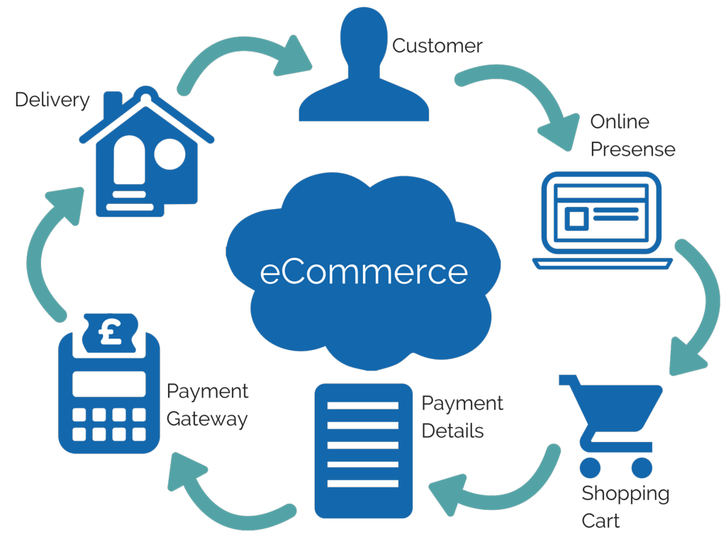
Notes:
The process flow of e-commerce starts, of course, with our customer. When (s)he decides to make a purchase, they will likely begin with a search. This search could be done using a search engine (like Google for example), or via an online merchant (like eBay for example) - as a result of this search, the aim is to have your online presence displayed to them.
Once they have selected their product(s), they add them to your shopping cart - think of this as a trolley in a supermarket. Single, or multiple items can be added into the shopping cart.
You will then need to collect payment details - this may include information such as delivery details, account details (if they have an account for the site).
At this point, the shopping cart information, along with the payment details are transferred to the payment gateway. This may be hosted on your own site, but is likely to be managed, hosted and processed by a 3rd party (like PayPal for example). This secure (payment gateways must be secure) gateway handles the payment information (card number, expiry and CVC - the 3 digits on the back of the card etc.) - once approval has been obtained by the payment gateway, this confirmation is sent back to your store to alert you that the item has been processed and is ready to be dispatched.

Slide 13
How much can businesses do themselves?
We have identified who and where our customers are
How do we reach them?
Lots of ‘use your own platform’ tools to utilise
OR - Some businesses are more comfortable outsourcing
Notes:
Trainer to lead the discussion so that the delegates realise the necessity of using professional help to build their e-commerce platform.
So now we are starting to get a clear picture of your e-commerce strategy, we can begin to make some strategic decisions. The biggest strategic decision we will be faced with from the outset will be “Can I do this myself, or do I need to outsource?”
There are many easy-to-use tools that help businesses create an online presence for their shop themselves. A common option is to have a purpose-built website created; but it’s not the only option.
For some businesses outsourcing maybe the best option.
This workshop is designed to guide you through these strategic decisions, so we will begin by acknowledging outsourcing, before going in depth into how we may do it ourselves.

Slide 14

Outsourcing your
e-commerce operations

Slide 15
Things to consider if outsourcing the creation of your online store
Cost
Having someone else will normally cost more out-of-pocket
Quality
Professionals who are experienced may be able to deliver a faster, more professional looking result
Service
What happens after the store is created? Will you receive training, support or guidance?
Notes:
Outsourcing is neither a good or bad thing in this context. It’s important to help the learners understand what the options are, so although there’s a good chance they will be in a position to do this themselves, we’ve included this opportunity to set the scene about what working with a contractor might look like.
Bear in mind that we’re not yet into the specifics of ‘websites’. So this topic could cover eBay stores, Amazon marketplace through to Facebook Groups - this is to help the learner understand the benefits and concerns of working with someone else.
There is no way to really estimate cost, it is very much dependant upon how many products you wish to sell, in what way, and if the company building your ecommerce site will also be involved in the day to day running. As with many types of website, the design time and expertise is where a large proportion of the costs will sit - so the more time it takes to design, the more it will cost. That said, basic sites might start around £3,000.

Slide 16

‘Do it yourself’
What options do you have?

Slide 17

Options….
Marketplaces - 3rd party website hosting the selling of your products/services
Platforms - utilising software to sell products from your own website
Notes:
The two e-commerce options for your business which we will explore in depth today are marketplaces and platforms.
There is a discernable difference between both options, with further functionality differences depending which particular product you choose, either within marketplaces or platforms.
The most fundamental difference between marketplaces and platforms is who has ownership. Marketplaces are owned and hosted by 3rd parties, with people selling on an existing infrastructure for a fee, whereas platforms are built and usually owned by the user.

Slide 18
Comparison of platforms and marketplaces
Platform | eBay integration | Amazon integration | Customisable
SquareSpace | ✅ | ✅ | ✅
WordPress | ✅ | ✅ | ✅
Shopify | ✅ | ✅ | ✅
Wix | ❌ | ❌ | ✅
Magento | ✅ | ✅ | ✅
Weebly | ❌ | ❌ | ✅
Tesco | ❌ | ❌ | ❌
Boots | ❌ | ❌ | ❌
ebay | ✅ | ❌ | ❌
Amazon | ❌ | ✅ | ❌
Etsy | ❌ | ❌ | ❌
Notes:
This is designed to be a high introduction to the range of platforms, marketplaces and tools - to be able to start the conversations around how they differ, and what might be a good fit for differing styles of customer. In the sections throughout this workshop, we’re going to look at some more detail about some of the tools detailed here.

Slide 19

Marketplaces

Slide 20
Marketplace Options
Online environments
Multiple sellers
Some marketplaces are better fit for certain products
Important to choose the ‘best fit’ for your offering
Notes:
Marketplaces are online environments serviced by multiple sellers. We’re going to discuss a couple of examples you’re probably already familiar with (eBay, Amazon etc.). Depending on your product(s) [range], other marketplaces may be available, or even more suitable, to you. These may be a good fit for your business and product range.

Slide 21
Test the market
Numerous marketplaces
All have different ‘typical’ product ranges
Some ‘specialist’ marketplaces
Test products across different marketplaces
Measure: which is best performing?
Focus efforts
Notes:
One of the great advantages of the internet’s ubiquitous marketplace services is the fact that you can sell many items, in many places. Of course, they don’t all have to be from the same place. If you feel you have certain items that would sell better on Amazon, and some on Boots - list them that way.
Just as a bricks and mortar shop would investigate the town or city they were considering opening a store in to ensure there was a customer base there - e-commerce stores must do the same due-diligence. As the cost of opening such a store is relatively low on a marketplace - this can be a great way to test the market place.
As time progresses, you will be able to see items that perform better on one marketplace, and focus your efforts (for those products) there.
For example, you may have a mixture of products and services. As an expedition leader, you may have a range of camping equipment (tents etc.) that you recommend to participants. This type of product would fit well within Amazon’s base. The service of the actual expedition however, would require a lot of backstory, credibility and customisation - and would therefore sit better with your own website. This split in product(s) is a great way to take advantage of marketplace association and cross-selling from one to another.

Slide 22

Marketplace Options

Slide 23

Allows certain (verified) sellers to sell their products
Operating as “trusted partners”
Not openly available to all
Associated credibility
If your products align with the type of shopper that may be using Tesco’s online marketplace - this can give a faster boost to your store.
Notes:
Allows certain (verified) sellers to sell their products through their marketplace. Operating as “trusted partners” rather than openly available to all - this approach carries an associated credibility with it (as it’s connected with a known brand). If your products align with the type of shopper that may be using Tesco’s online marketplace - this can give a faster boost to your store.

Slide 24

Household name
Synonymous with household, cosmetic, beauty and toiletry products
Although Amazon has a greater brand recognition within the overall marketplace, items like toiletries don’t sell as well on Amazon - so sellers promoting this style of product may find value in looking at Boots.
Notes:
Boots: Boots is a household name and synonymous with certain household, cosmetic, beauty and toiletry products. Although Amazon has a greater brand recognition within the overall marketplace, items like toiletries don’t sell as well on Amazon - so sellers promoting this style of product may find value in looking at Boots.

Slide 25

Generous supply of existing users
Resources to run supportive advertising
This drives additional virtual footfall to its service
Increases the potential audience
Final valuation fee
Notes:
eBay has a generous supply of existing users, andhas the resources to run supportive advertising for its service.
This drives additional virtual footfall to its service, and increases the potential audience your business can get to your online presence.
When you sell on eBay, you will be charged a final valuation fee that you should include in your overheads.

Slide 26
Your final value fee is 10% of your total transaction cost (including postage)
You only pay a final value fee if your item sells.
You'll never pay more than £250 as a final value fee.
If your buyer pays with PayPal, you'll have additional PayPal fees.
Notes:
Important to notice, the final valuation fee is only charged IF your item is sold. This means if you have listings that do not sell, it will not cost you money. This offers a cost effective method of selling.

Slide 27
Who may be a good fit for?
Sellers wanting to sell a variety of products to a mass audience
High footfall and market share
High appeal for those wanting a ‘pop-up’ store
If you’re wanting more control over what your store looks like, does or behaves - you may want to investigate other options.
Notes:
Sellers wanting to sell a variety of products, and to a mass audience. With eBay’s high footfall and market share, it has a high appeal for those wanting a ‘pop-up’ store without needing to worry about having to set a lot of stuff up. If you’re wanting more control over what your store looks like, does or behaves - you may want to investigate other options.

Slide 28

304 million users (4th quarter of 2015)
Marketplace for many different products
Strong presence in technology items and books
Structured marketplace - limited customisation
Notes:
Amazon aims to be known for a marketplace for many different products, but generally categories would make it a good fit for those pushing technology items or books.
Like with any structured marketplace, the amount you’re able to customise your store is limited.

Slide 29
Amazon fees
 | Basic (Sell a little) | Pro (Sell a lot)
Designed for sellers who plan on selling | Fewer than 35 items a month | More than 35 items a month
Key plan benefits | Pay only when you sell something | Best value for volume sales
Monthly Subscription Fee or Per-Item Fees for each product sold on amazon.co.uk | £0.75 (Per-Item Fees for each product sold on amazon.co.uk) | £25 (Monthly Subscription Fee)
Notes:
Amazon has two different plans for sellers: Basic, for those selling less than 35 items per month and Pro for those selling more than 35 items per month.

Slide 30

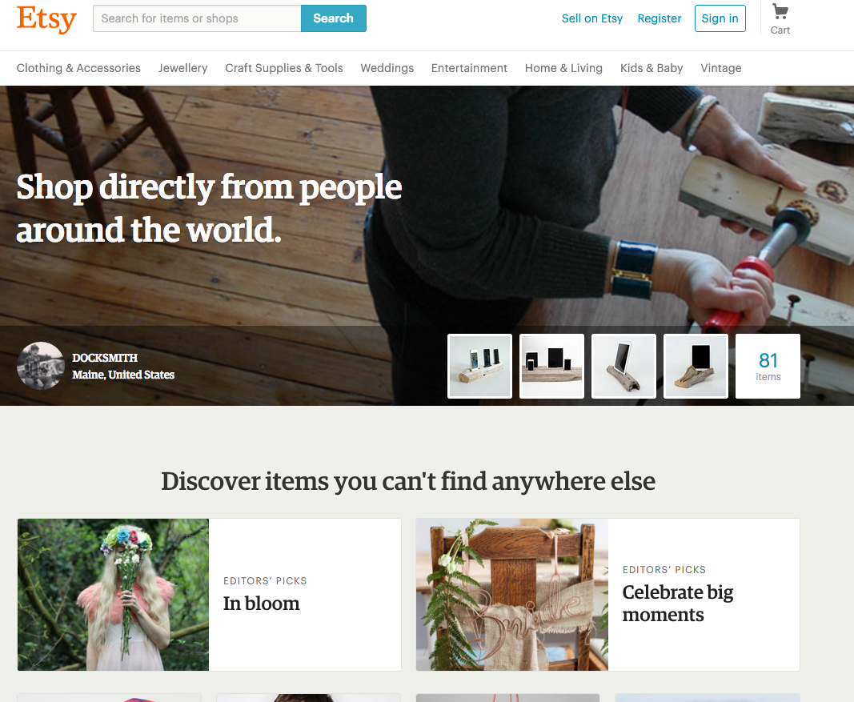
Notes:
54 million users (as of the 4th quarter of 2015)
Etsy has a strong community of craft sellers - this may be a niche audience, so is not going to be the right fit for all learners - however, if their product belongs within that community, Etsy has a lot of offer in reach and supportive advertising (they run Google Adwords to drive footfall to the site), and requires little or no experience of technical skill to set up the store.

Slide 31
Fees
Listing fee of $0.20 USD (~14p) per item that you list for sale on Etsy’s website or mobile apps
You will be charged a transaction fee of 3.5% of the item price when it sells
Notes:
You will be charged a listing fee of $0.20 USD (~14p) for each item that you list for sale on Etsy’s website or mobile apps. You will be charged a transaction fee of 3.5% of the item price.

Slide 32
Who may be a good fit for?
Highly niche
Dominated by homemade and craft items
More options available for customisable products
Focuses on the visual aspect of the product
Pricing is simple, and fixed
Selling smaller volumes of low cost items may not be as profitable because of the listing fees
Notes:
Highly niche
Dominated by homemade and craft items
More options available for customisable products
Focuses on the visual aspect of the product
Pricing is simple, and fixed
Selling smaller volumes of low cost items may not be as profitable because of the listing fees

Slide 33




Notes:
There are a multitude of online marketplaces to choose from, with some selling multiple product ranges (e.g ebay) to more specialist marketplaces, like asos marketplace for fashion items. If you have a particularly niche product, research what platforms are out there and look for similar businesses to yours, where are they selling?
Important to point out to delegates, these are just a selection of what is out there, and for the purposes of this workshop we will look in depth at a couple of the more widely used marketplaces.

Slide 34

Integrating your e-commerce with a marketplace
Some platforms give the option of integrating with a marketplace (or sometime multiple).
For example, you may want to manage your stock via your own web presence - but also list your products on a marketplace, like Amazon.
Notes:
The advantage of this could be to get a greater reach with less time. Listing once on a ‘central’ presence and having a tool that manages additional listings can save significant time and reduce errors in pricing and stock availability. Additionally, integration allows orders to be managed, responded and processed from a single point - ensuring nothing is missed and improving your customers’ overall journey.
Examples (Trainers can replace with examples of their own) -
Shopify provides integration with eBay and Amazon (https://www.shopify.co.uk/resources/integrating-website-with-ebay-and-amazon)
Veeqo facilitates WooCommerce (WordPress e-commerce plugin) integration with Amazon (listing available) and eBay (listing not yet available) (http://www.veeqo.com/woocommerce-integration)
Boost my shop provides Amazon connection too (https://www.boostmyshop.com/uk/amazon-for-magento.html)

Slide 35
Platforms

Slide 36

Building your own e-commerce presence
Marketplace may not be the right fit
You may choose to build your own online presence
Advantages and disadvantages
Notes:
Using a marketplace for your online shop may not be the right fit for your business, and you may choose to build your own online presence. We’re going to discuss some examples of platforms that you could use to do this and the advantages and disadvantages you may face.
The purpose of this section is not to convince or deter the learner from embarking on this process (self-build), but as with the rest of the course, to lay out an option.

Slide 37
Using an integrated
e-commerce solution
Allows easy control of stock (so you don’t sell more than you have)
Allows you to upload images of your products, set prices, add a description - your product is now available to sell
Usually allows for order management
Allows you to create consistent branding, which means a more pleasant purchasing experience

Slide 38

1.8 million users (2nd quarter of 2015)
Simple, fast way to build an online presence
Not too technical
Fees:
$216/year (or $26/month) (~£150/year - or £18/month)
Sell up to 25 Products
2% Sales Transaction Fee
Notes:
1.8 million users (2nd quarter of 2015) Gives a simple, fast way to build an online presence without the need for much technical knowledge.
We’ve chosen SquareSpace as an example because of simplicity. While this options sits between the pre-made structure of a marketplace and the potential full-freedom of building your own site - the options it provides are likely to be a good fit for many businesses. SquareSpace isn’t the only provider of this type of structure, so if there’s an alternative that you would like to demonstrate to the learners,

Slide 39

Example of
Notes:
http://www.dixiechicks.com is built on SquareSpace - click this link, or the screenshot of the site to load dixiechicks.com
Additional or alternative examples can be found at https://www.squarespace.com/customers/

Slide 40
Who may SquareSpace be a good fit for?
Makes it easy to create a website
Those looking for functionality provided in a smooth, fast and structured way
If you’re likely to want more functionality to be added, it’s worth assessing all the options.
Notes:
SquareSpace makes it easy to create a website, so for businesses that are happy to have that functionality provided in a smooth, fast and structured way, it may be the perfect choice. If you’re likely to want more functionality to be added, it’s worth looking at all the options.

Slide 41
37.5 million users [of the software] (4th quarter of 2015)
E.g Woocommerce as a plugin (enhances the functionality of WordPress to include e-commerce).
Several options for integration with a payment solution - most popular is PayPal
PayPal fees range from 1.9% + 20p per domestic transaction to 3.4% + 20p
Notes:
It’s not a fair comparison in the same way that eBay or Amazon has ‘users’ as this figure related more to those who use the software, rather than those who shop on the service - but it’s common, and wide-spread, so the support community is readily available too.
WordPress in and of itself isn’t actually an e-commerce provider, so we’ll assume the use of Woocommerce as a plugin (enhances the functionality of WordPress to include e-commerce). Woocommerce gives several options for integration with a payment processor. The most popular, and common, is PayPal. As we’ve already discussed, the fees for PayPal are based on your total sales volume and range from 1.9% + 20p per domestic transaction to 3.4% + 20p

Slide 42
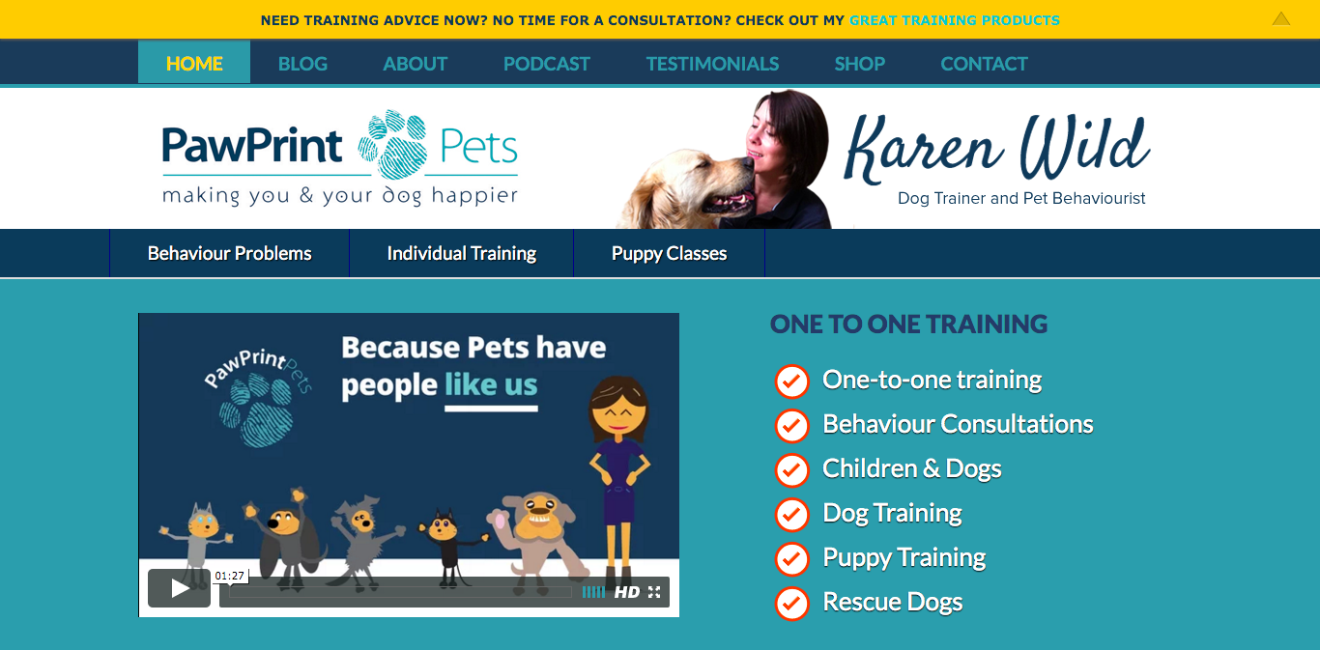
Example of with WooCommerce
Notes:
Load site: http://pawprintpets.com/ (or click image on slide)
While WordPress isn’t an e-commerce solution out of box, it is one of the most commonly used platforms used by businesses to build their own site. WooCommerce (other e-commerce plugins are available) can be added to WordPress at no cost which adds this functionality.
This combination of software gives good scope and flexibility, and can grow with the business - but it does require a degree of skill that novices may struggle with.
Note to trainer: If you’re more familiar with an alternative CMS platform (Joomla, Drupal etc.) this can be substituted here.

Slide 43
Who may be a good fit for?
Requires the most technical skill to set up of all examples used
Scalability
More advanced functionality
For individuals who are not comfortable with learning new skills, other options (marketplaces etc) maybe a better fit.
Notes:
Requires the most technical skill to set up of all the examples we’ve used. For businesses that need a system that scales with them, and can provide more advance functionality, this may be a great option.
For individuals who are not comfortable with learning new skills, other options could be a better fit.
Note to trainer: It is worth stressing that web design/development is a skill like any other, and is not necessarily something that all learners could, or should, embark on. Using a professional to build an e-commerce site will increase the likelihood of the site looking and functioning better. That said, we are laying out options that are available, so it may be suitable for some. Use this opportunity to discuss with the learners to establish their technical and design ability, and help steer them to the best route for the progress.

Slide 44






Notes:
There are some alternatives for people wanting to build their own website. Functionality differs on different platforms, but with varying degrees of integration - any platform could be used as an e-commerce platform.

Slide 45
Platforms and who’s using them
Platform | Active sites
WordPress | 12,711,448
Magento | 245,022
Shopify | 175,811
Wix | 1,111,691
Weebly | 582,902
45
Notes:
Data sourced from builtwith.com for each platform (for example http://trends.builtwith.com/websitelist/WordPress).

Slide 46

Payment Solutions
Notes:
Some marketplaces have integrated payment solutions, others have preferred payment solution partners, and others rely on the seller having a payment solution to direct customers to.
The most commonly used payment solution employed tends to be Paypal…..

Slide 47

Processes millions of payments for customers worldwide
Transaction fees based on total sales volume
Fees range from 1.9% + 20p per domestic transaction to 3.4% + 20p
The more you sell, the less you pay
There are certain criteria on eBay that requires you to accept PayPal as a payment option, but other options are available (Money Order, Cash, Cheque etc.)
Notes:
PayPal helps process payments for millions of customers worldwide. Their transaction fees are based on your total sales volume and range from 1.9% + 20p per domestic transaction to 3.4% + 20p. So the more you sell, the less you pay.
There are certain criteria on eBay that requires you to accept PayPal as a payment option, but other options are available (Money Order, Cash, Cheque etc.)

Slide 48




Alternatives to PayPal
Notes:
As with any specific platforms or solutions we present within this workshop, alternatives are available. We are simply highlighting specific platforms due to their popularity or features, so we can showcase how each solution may work for you.

Slide 49
Pakistan Banks Foreign Payment Acceptable method
MoneyGram payment method accepted by all Pakistani Banks
Western Union Payment method is accepted by all Pakistani Banks
PayPal is not exist in Pakistan
Google Payment is not exist in Pakistan
Wire transfer is available

Slide 50

Measuring the effectiveness of your online presence

Slide 51

Google Analytics

Slide 52
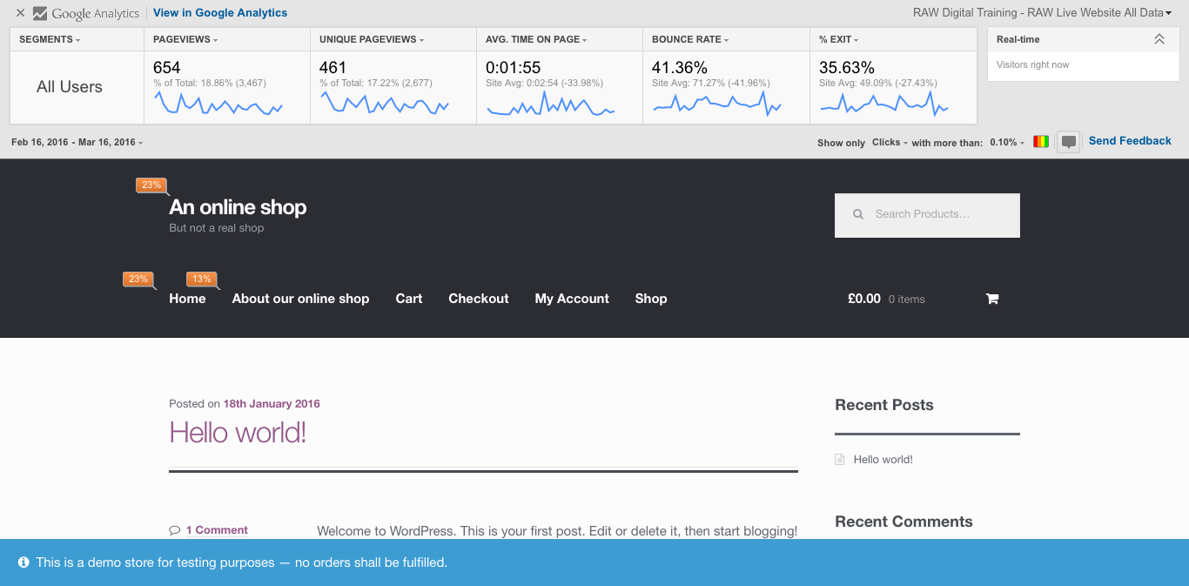
Notes:
The GA plugin can show which links are being clicked on, which gives the user an insight into whether CTAs are working, whether they are driving their online visitors to the right place.

Slide 53

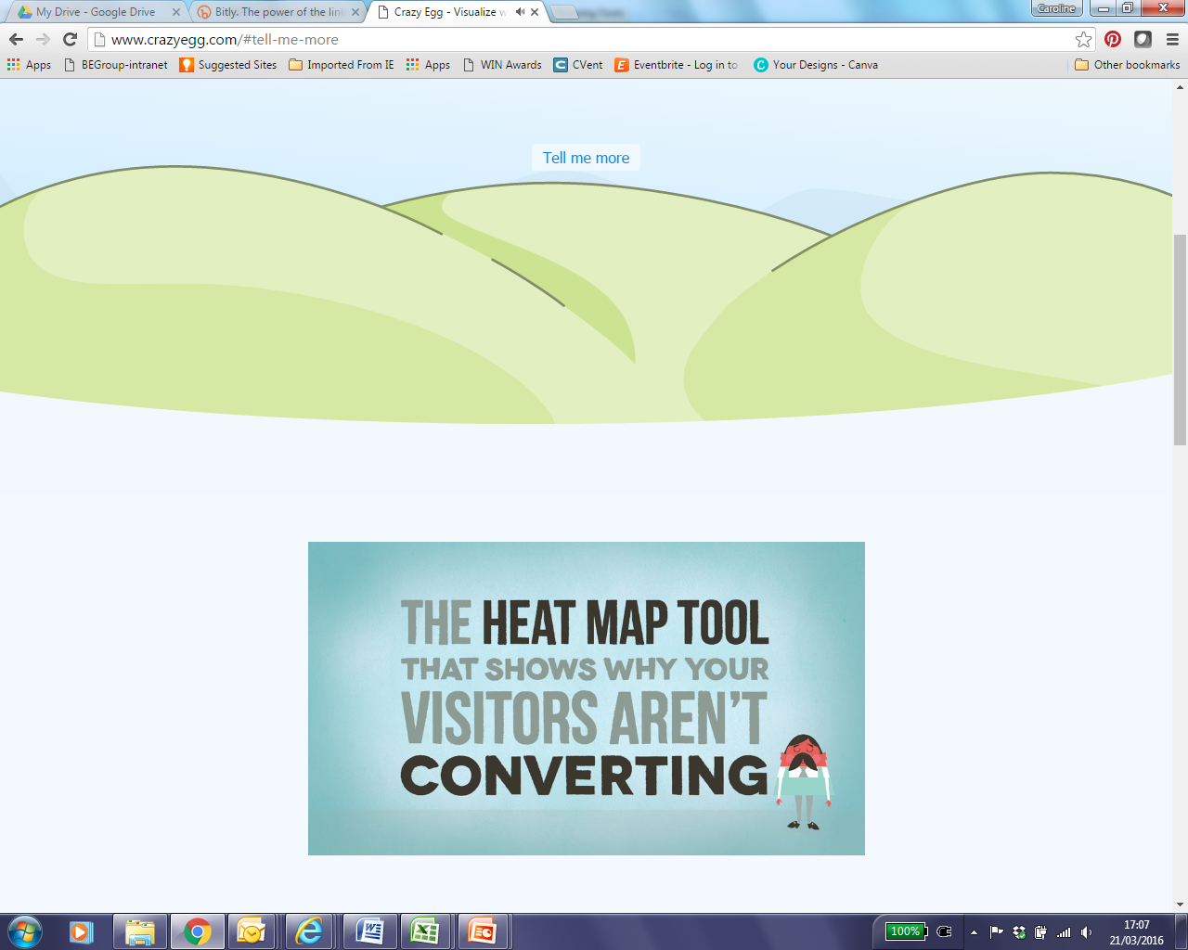
Video link - http://www.crazyegg.com/#tell-me-more
Notes:
Trainer to play Crazy Egg video by clicking link on slide.

Slide 54

Optimising products on offer

Slide 55
Why optimise your products?
Competitive edge
Customer experience
Aesthetics
Accurate information
Directly informing and influencing the purchasing decision of customer
Notes:
Whether we are using marketplaces or our own ecommerce website, it is vitally important we optimise the products we have available.
If we are using marketplaces, we are likely to be selling similar products to other sellers, therefore our customers have a choice of who to buy off, us or somebody else. Therefore we need to provide the customers with the best experience we can, which includes presenting our products well both aesthetically and making sure all accompanying information is accurate and provides everything the customer would need to know to make a purchasing decision.

Slide 56
Optimising product images
Your potential customer must be able to see, clearly, what is being offered.
This applies both literally and figuratively.
Let’s take a look at some examples of product images, how would you respond as an online shopper...
Notes:
Images are well known for drawing shoppers eyes - so getting it right is essential. The next few slides will show some examples of images that could be used to promote a specific product.
As you show each image to the learners, discuss any good point, bad points and how they may feel it would affect the user experience - and therefore the buying experience.

Slide 57
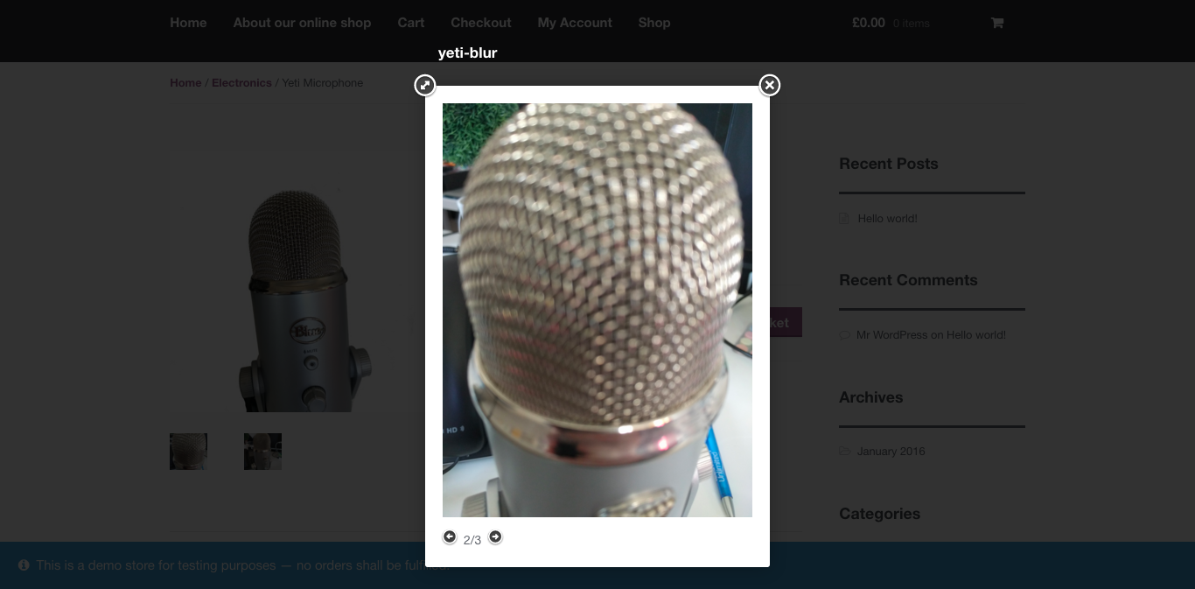
Notes:
Discussion with the group: What do they think?
Image is too close, and out of focus - it is not clear what it is

Slide 58
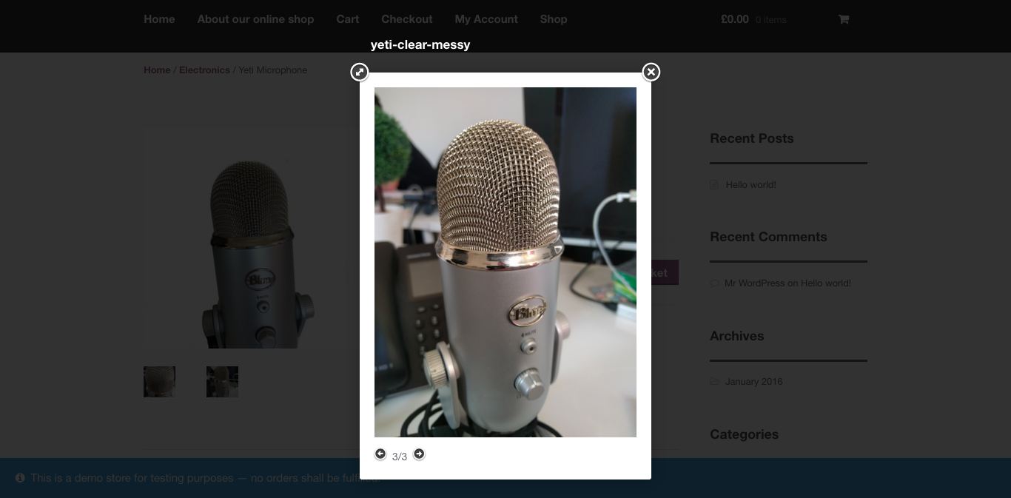
Notes:
Discussion with the group: What do they think?
Image is in focus - does the background demonstrate how the product may be used, or is it a distraction from the product?

Slide 59
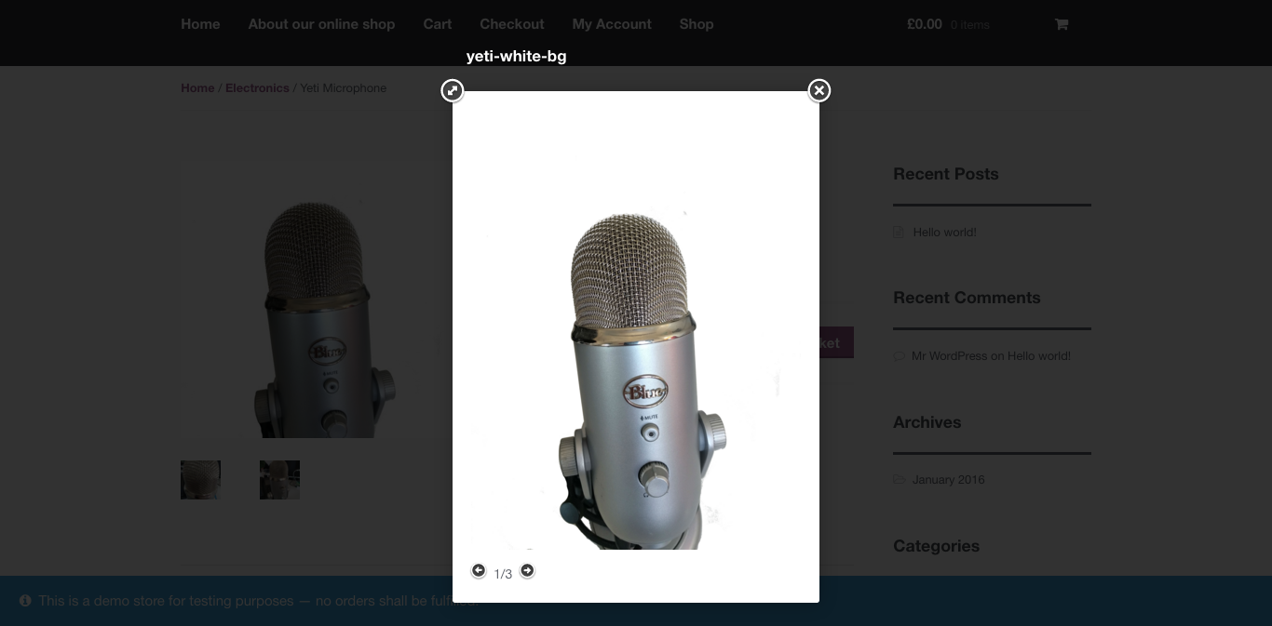
Notes:
Discussion with the group: What do they think?
Image is in focus and has been isolated.

Slide 60

Optimising Copy

Slide 61
Writing copy
When writing copy, it is essential to spend some time to think carefully about how your copy should flow, the style and use of keywords.
The aim of your product copy is to explain clearly and concisely, to your customer, what the product is, what it does and any options they may have.
Notes:
The two main components of copywriting in this context are user experience and SEO. We want to make sure that copy focussing on SEO best practices -
Title
Keyword Representation
Alt Tag (if available)
But, the main focus here is to get the best possible experience.

Slide 62

Get 30-100% more conversions
Quality product descriptions can transform e-commerce conversion rates. It’s common to see increases of 30-100%.
As well as converting more visitors, search traffic increases drastically when unique copy is written for each product.
Notes:
Most online retailers use manufacturers’ copy or rely solely on images to sell products. They then use inadequate copy elsewhere on their site and fail to achieve a consistent tone to persuade their audience. This creates a compelling opportunity for savvy retailers — by writing quality e-commerce copy you will create a unique competitive advantage.

Slide 63

Goals for copy
Establish trust
Convince visitors that your product is right for them
Notes:
Potential customers cannot see or touch the product since it’s not physically there in front of them. This is why it’s important that your copy anticipates the needs of your visitors while convincing them that your company can be trusted to provide excellent products. Persuasion and creating trust are difficult things to do with words alone; yet, they are still achievable.
You must establish the right tone, a mix between informative and engaging, while showcasing your product’s usability, practicality and benefits. If the copy on your website makes sense, it follows that your products and services will meet your customers’ needs.

Slide 64

Tips for copy
Use bullet points
79% of people scan pages rather than read fully
Avoid long sentences
Speak simply
Notes:
Bullet points: E-commerce websites should usually opt for a combination of bullets and paragraph form. When 79% scan the page versus read word-for-word, bullets effectively communicate key product details and benefits. Paragraphs add color and texture to your products, eliciting a deeper emotional response.
Long sentences: Long sentences are usually difficult to digest and therefore inappropriate for persuading your audience. To shorten sentences, avoid pointless modifiers and break up independent clauses into two separate sentences. Avoid wordy phrases such as “for the purpose of” when “for” will do, and refrain from peppering your copy with too many adjectives and adverbs.
Speak simply: Your writing should be easily understood. There’s no reason to use complex words in product descriptions. You are going for simplicity, not trying to impress your readers with your vocabulary. Using large words will either sound like you’re trying too hard or lead to confusion.

Slide 65


Other optimisation opportunities
Video - Is your product suitable for a short video?
Responsive design - Is your e-commerce site optimised for viewing on mobile?
Notes:
Video - Is your product suitable for a short video? If you can highlight USP of your product, highlight its quality or functionality, or anything else that may influence purchasing decisions using video, then why not include a video on the product page? Responsive design - Is your e-commerce site optimised for viewing on mobile? - Users of the internet are increasingly using mobile devices over any other form of device to access the internet and purchase products. Therefore it is essentially important to think about the user experience and serve up mobile optimised websites in order to engage our customers and enhance the likelihood of purchase.

Slide 66
Ecommerce strategy for your business

Slide 67

Developing your e-commerce strategy
Is this the right time?
What do you want to sell online?
Where are your customers?
How do your customers shop?
Does the business have capacity?
Which solution is best for you?
Notes:
Like any area of business, we need to develop a clear strategy, which helps us understand where we are now, where we would like to be, and what we need to do to get there. Before setting off on your e-commerce journey, it is very important to have a clear understanding of:
Is this the right time? - presumably by attending this course you have either decided now is the right time to begin selling online, or you are thinking of doing so in the near future.
What do you want to sell online? - So now you know it is the right time to go online, lets consider, are your going to sell ALL of your product range online? Or are some ranges more / less suitable than others?
Where are your customers? - Are you selling UK wide or are you able to sell to Europe or worldwide? Are there any restrictions to where you can sell your product?
How do your customers shop? - where are your prospective online customers currently buying similar products to yours? Do they have a certain expectation of how they buy online? Are they used to certain platforms?
Does the business have capacity? - Do you have the correct knowledge, infrastructure and time to devote to your e-commerce efforts as well as any bricks and mortar operations?
Which solution is best for you? The answers to the above questions will all inform which platform you choose to employ, when and how.

Slide 68

Confirming orders
Automated response to new orders
Customer gets an email to confirm that their order has been received
Aids with credibility
Enhances buying experience
The email should contain:
That the order has been received
What was ordered
How much (in the relevant currency to the buyer) the total transaction is
Dispatch information
This process all helps to manage your customers’ expectations and enhance their buying experience..
Notes:
The systems we’ve discussed so far allow for the automated response to new orders. This means that the customer gets an email to confirm that their order has been received.

Slide 69
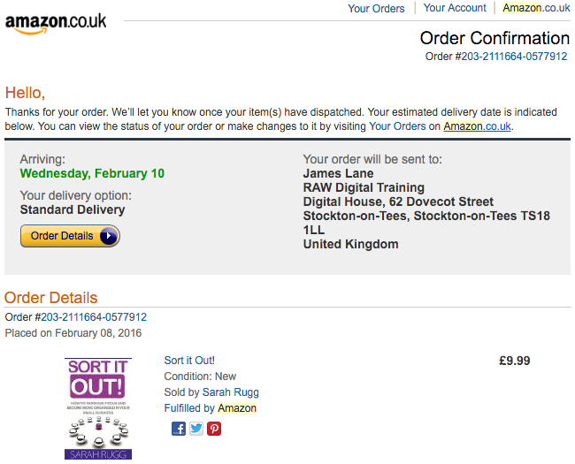
Notes:
An example of order confirmation email copy following an online order

Slide 70

Fulfilling orders
Selecting your customers’ order
Do you hold stock?
Can your supplier ship direct?
Notes:
At this point, the expectations of your customer should be high - they’ve had a great experience of shopping with you. It’s obviously essential that the correct product is now selected based on their order. Having your stock organised correctly and efficiently will help reduce errors in fulfilment.
There may be a situation where you don’t hold all items in stock, so it’s essential that this is communicated to your customer as soon as possible - ideally before they’ve ordered. Keeping them informed about the progress of their order will help manage their overall experience of both you and their order.
In certainly circumstances, your supplier may be able to ship direct to your customer without the product(s) going through you. This reduces your time, and the amount of stock you need to physically keep yourself. This process is called drop shipping.

Slide 71

Tracking information
Depending on your choice of shopping partner, you may be able to include tracking information.
Allowing you customer to track where their order is, is a great way to maintain your relationship with them, and it also helps to avoid the customer having to contact you to find this information out (which can take up your time, taking that effort away from your business)

Slide 72
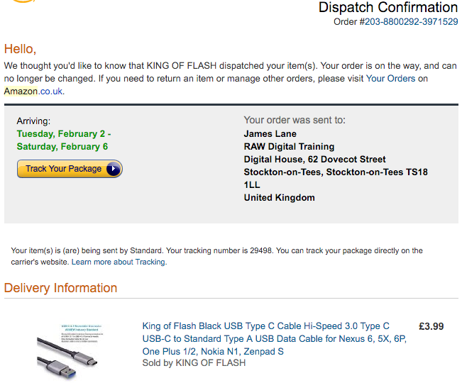
Notes:
An example of dispatch confirmation email copy following an online order

Slide 73
What do you need to do after the order is complete?

Slide 74

After delivery
Feedback
After our customer has received their order, we need to check -
They are happy with the item(s)
Whether there was anything else we could have done to improve the experience
This information is vital to an online business.
Notes:
Think about your experience in a restaurant, you will likely be asked “How was your meal?”. The process for e-commerce is exactly the same.
We can seek feedback in different ways, depending upon which e-commerce solution we are using.
Marketplaces: Marketplaces usually have built in features for leaving feedback (both customer to seller and seller to customer in some cases) to assist purchasing decisions in terms of other customers being able to see feedback a seller has got for previous transactions.
E-commerce websites / platforms: As part of the post sale communication with customers, after your product has been delivered, why not send an email to ask if everything was ok, what they like about your product and buying experience and if there is anything you can improve on in future.
Use this information to not only inform your products and services, but also to inform your e-commerce strategy in terms of are you utilising the correct platforms and processes accordingly.

Slide 75
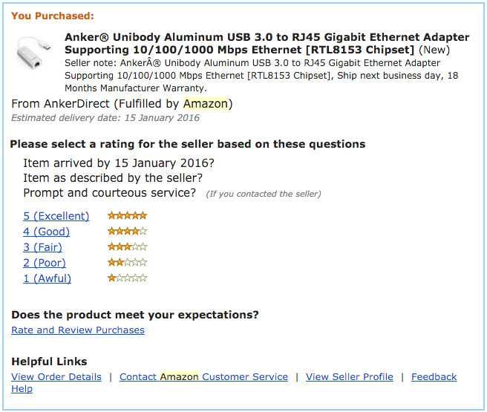
Notes:
An example of email content sent after an item has been delivered.

Slide 76

Options for collecting reviews externally
Notes:
There are also external websites where customers may leave reviews about your product and the experience they had in buying from you.

Slide 77
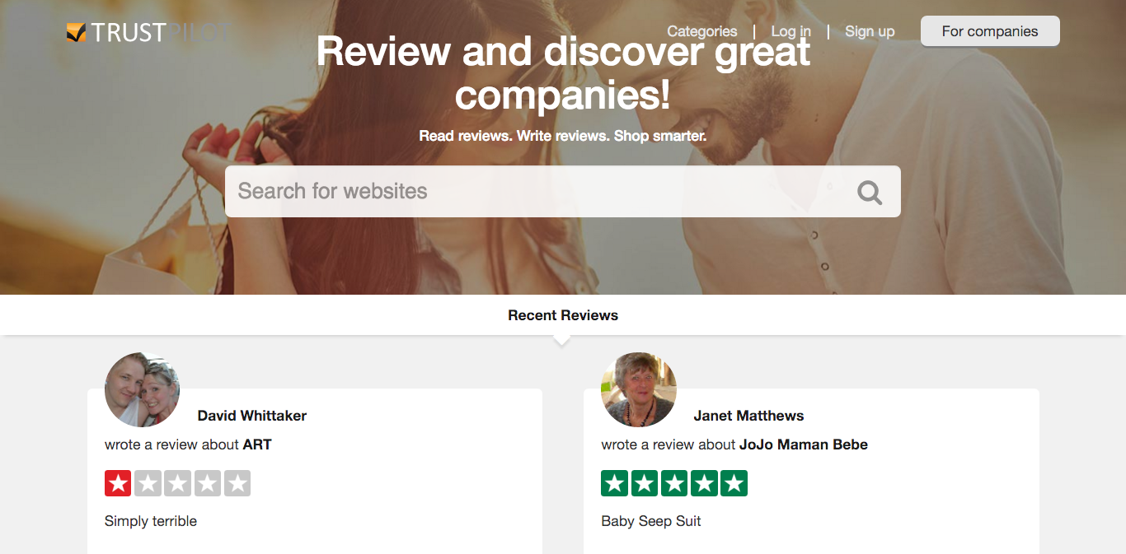
Notes:
TrustPilot is a popular tool used to collect reviews of products - it can (dependant on circumstances) automated in many cases. This removes the possibly laborious activity of manually contacting individual purchasers.
One option for this, is if your online store uses PayPal. PayPal provides an Instant Payment Notification (IPN), and the IPN can be used to push details into TrustPilot to then trigger a review to go out at a fixed time.
For example -
Purchase Made > IPN trigger > Review email sent 7 days post purchase date > Customer completes review

Slide 78
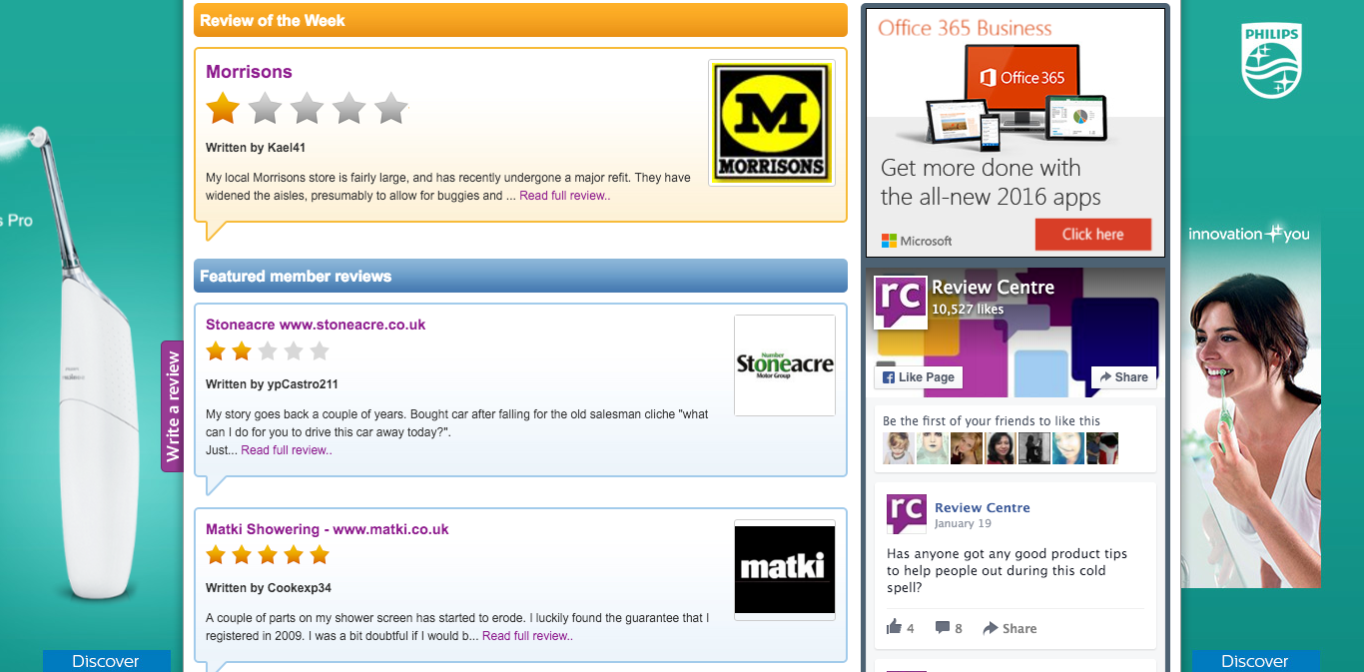
Notes:
Review centre is an alternative review service.
If you have an alternative, this case be substituted here.

Slide 79
Optimising and staying safe when selling online

Slide 80


Shopping Cart Abandonment
80

Slide 81
Shopping Cart Abandonment
The average documented online shopping cart abandonment rate is 68.63%
As you can see, abandoned carts account for huge potential losses in e-commerce. Identifying why these happen, and what to do to avoid them could have a massive impact on your online store.
Notes:
Source: http://baymard.com/lists/cart-abandonment-rate

Slide 82
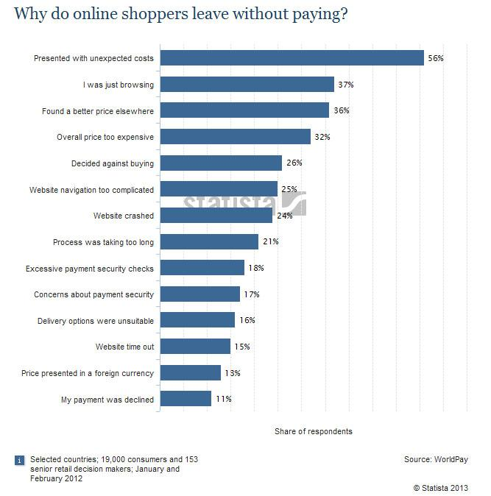
82
Notes:
As you can see, the price sensitivity issue(s) actually come in from the third position on, with the majority of respondents leaving after being presented with unexpected costs. Other issues focus around issues surrounding user experience, and technical issues.
Note to trainer: this is a great discussion point with learners to see what issues their customers may face, and what steps store owners can take to mitigate those risks.

Slide 83
How do you fix abandoned carts?
Transparency
Think about your customer, their journey through your store and how satisfied they might be
Abandoned cart emails
Notes:
Transparency - being clear and upfront about your pricing goes a long way to helping customer make the choice to shop with you. Seeing that most customers cited “unexpected costs” as their abandonment reason, advising if your prices don’t include VAT (or similar tax(es)), shipping charges (this may be to certain, remote locations) and handling costs, could go a long way to building trust with your customers.
Customer journey/UX - you may find it a breeze to navigate your website, but you were part of the design process. If your customers can’t find what they’re looking for, they’ll more than likely leave. Think very carefully about what that journey looks like for your customer(s) - consider testing to see how an impartial group find the navigation and experience on your online store. Be prepared to change your store in line with their comments.
Some services allow you to see abandoned cart emails - reminders that encourage the shopper to return to your store to complete their purchase. You may have experienced this yourself as a customer - emails may include additional offers (return to your cart and get an additional 10% off) to increase return rates.

Slide 84

Maximising basket size
Notes:
An opportunity for cross and up-selling for sellers can be a great opportunity for ensuring that shopping cart values are maximised.
This is a common technique employed by retailers in bricks & mortar stores as well as e-commerce.

Slide 85
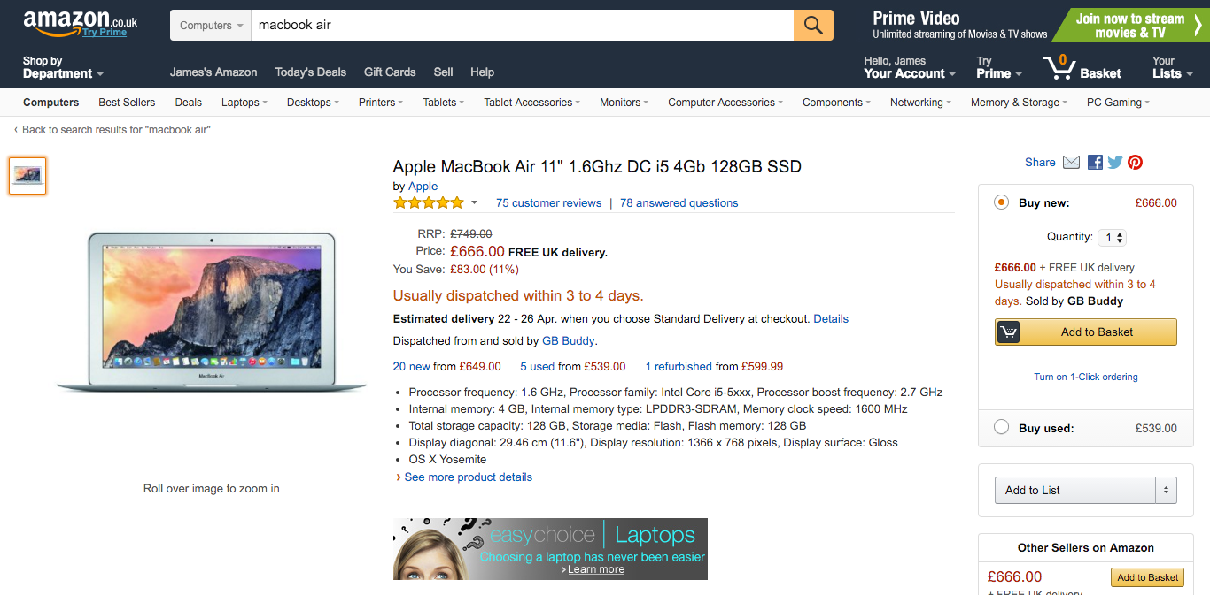
Notes:
Here’s an example of a product (MacBook Air) on Amazon - we’re using Amazon as an example - if you have an alternative demonstration, this can swapped out.
As the store knows we’re interested in this product, it can partner two important suggestions into our shopping experience...

Slide 86
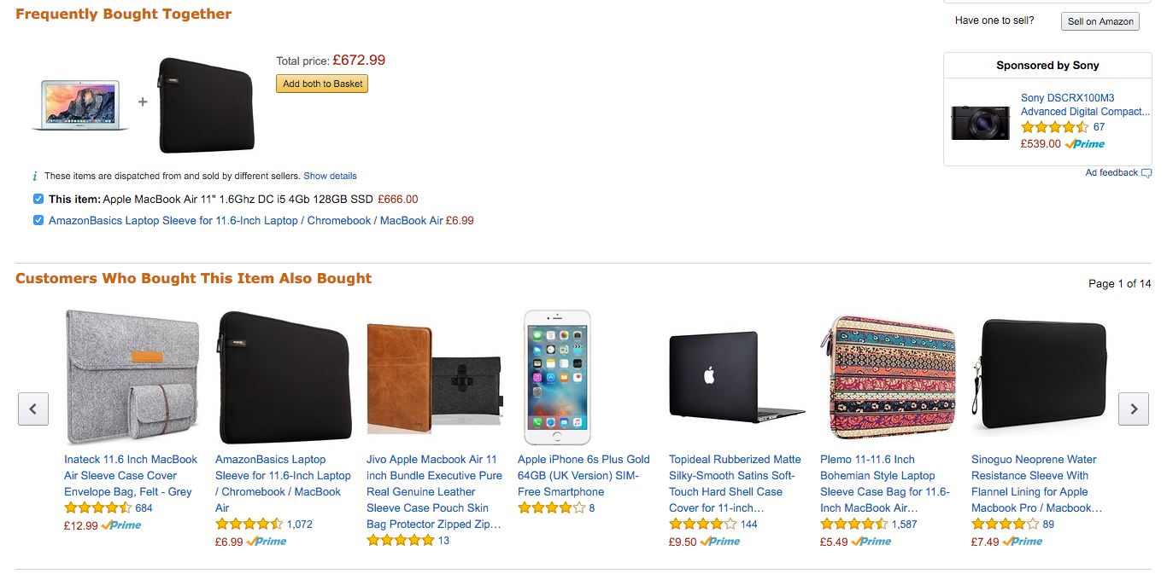
Notes:
As we can see here, the store is presenting two key opportunities to increase basket values.
Frequently Bought Together - this is similar to physical stores that may offer batteries as you purchase an electrical item. This process relies on the credibility of other purchasers - because it’s not the store itself that’s suggesting that the additional purchase should be made, but instead suggesting that other purchasers often purchase the suggested multiple items. This makes us, as consumers, more likely to add the item.
Customer Who Bought This Item Also Bought - The lower carousel lists alternative products, that have been purchased with the viewed item - so in this case, it’s items that have been purchased with the MacBook Air. They aren’t necessarily frequent enough to make it to the ‘Frequently Bought Together’ section.

Slide 87

Repeat sales
Initial sale is often the main goal of our marketing efforts
But, what is next after the initial customer conversion?
Repeat sales are a huge goal for any successful retail business
Great customer experience
Great products
Great after care
Feedback
Use others feedback to market to new customers - peer reviews
Notes:
Making an initial sale is often a main goal of our marketing efforts. If someone is not a customer, converting them to a customer is obviously of great benefit.
Repeat sales, however, is a huge goal for any successful retail business.
Creating a great experience for your customer will help to ensure that they come back time and time again.
Asking for their feedback is a great way to do this, so you know what areas of your offering (what you sell, and the way that you sell it) they love, and which areas they’d like to you to do better.

Slide 88
Cyber security risks when trading online

Slide 89

Backing up your website
Keeping records of your orders, customers and transactions
This is normally available within the ‘orders’ section which allows you to export a copy of your data
You should backup your whole self-hosted website to either a service, or your computer in the event that you have to rebuild the website.
Notes:
Keeping records of your orders, customers and transactions can be helpful should anything happen to your online store. This is normally available within the ‘orders’ section (note that this may be called something slightly different in each system) - which allows you to export (save) a copy of your data. If you have a self-hosted website (WordPress for example), you should backup the whole website to either a service, or your computer in the event that you have to rebuild the website.

Slide 90

Backing up your website...cont
Backups should be kept safely and securely. If using a hard drive, ensure that this device is, itself, protected. For example, keep an external locked away to avoid it becoming lost, stolen or damaged.

Slide 91
How do you know when an order is genuine?
Checks can be made to ensure that an order is genuine
Manual checks that details have been entered in correctly
More robust automated checks that payment processors can perform - like card verification
Having procedures in place to protect your customers and you are mutually beneficial

Slide 92
Protecting your online business and keeping accounts secure
Notes:
***Not sure if best title?***

Slide 93

Are you storing your customers’ data?
93

Slide 94

If so, you must comply with….
Data Protection Act
Distance Selling Regulations
E-Commerce Directive
Cookie Law
VAT when selling out of the EU
94
Notes:
Data protection act (https://www.gov.uk/data-protection/the-data-protection-act)
Distance Selling Regulations (http://www.legislation.gov.uk/uksi/2000/2334/contents/made)
E-Commerce Directive (http://www.legislation.gov.uk/uksi/2002/2013/contents/made)
Cookie Law (https://ico.org.uk/for-organisations/guide-to-pecr/cookies-and-similar-technologies/)
VAT (https://www.gov.uk/guidance/vat-exports-dispatches-and-supplying-goods-abroad)

Slide 95
Keeping your online presence safe
E-commerce presence can be susceptible to problems, whether accidental or malicious
Different solutions have varying degrees of protection
e.g solutions that are hosted for you (eBay or Amazon for example) will provide a degree of protection as your shop is a part of their service
However, no service is perfect
You should take steps to ensure that your data is protected
Notes:
Like with any website, your online shop can be susceptible to problems, whether accidental or malicious. Different solutions we have discussed throughout the workshop will have varying degrees of protection. For example, solutions that are hosted for you (eBay or Amazon for example), will provide a degree of protection as your shop is a part of their service. However, no service is perfect and you should take steps to ensure that your data is protected in the event that something should go wrong.

Slide 96
Keeping your site safe
Whether you choose marketplaces or platforms you will need a strong password
Avoid easy-to-guess passwords (like 123456 or Password1)
This will help reduce the likelihood of it being guessed and your site/data being breached
Consider using 2-step verification
This utilises a mobile device - so you’ll need your username, password and a PIN (from your mobile) to access your site
Notes:
Whichever system you choose, you will more then likely need a password to protect it. It is essential that this password is a strong password. Avoiding easy-to-guess password (like 123456 or Password1) will help reduce the likelihood of it being guessed and your site/data being breached. Where available, consider using 2-step verification to ensure that an additional step is needed to log in. This is usually a mobile device (your smartphone) - so you’ll need your username, password and a PIN to access your site.

Slide 97
Questions?

